Slide 1
Data
Collection
Shahriar’s Analytical Academy

Slide 2
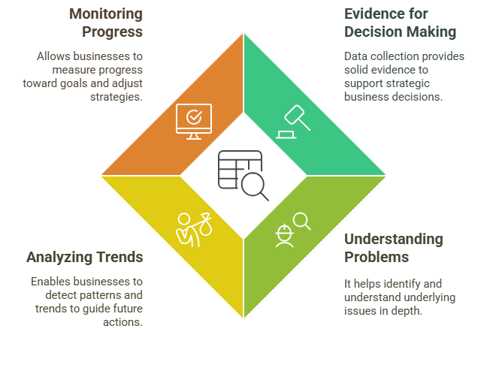
Data Collection
Data collection refers to the process of gathering, measuring, and analyzing accurate insights about the variables of interest in a systematic and organized manner.
It forms the foundation for any research or business decision-making process.
Notes:
Definition of Data Collection: Data collection is the methodical process of gathering, measuring, and analyzing data on various aspects of a business or research topic. It’s the foundation for making well-informed decisions and discovering patterns or issues that require attention. This process ensures that decisions are based on factual evidence, rather than assumptions.
Importance of Data Collection in Business:
Provides Evidence for Decision Making: Data collection is crucial for businesses to make sound decisions. Instead of relying on guesswork, data provides concrete evidence that supports strategies and actions. For example, sales figures or customer feedback might inform decisions about product improvements or marketing campaigns.
Understanding the Problem: After identifying a business problem, collecting data allows you to dig deeper into the root causes. This thorough understanding enables businesses to develop solutions that are more effective and tailored to the specific issue.
Analyzing Trends: Data collection helps identify historical trends or predict future behaviors. For example, sales data collected over time might show seasonal patterns, helping a business plan marketing efforts or inventory purchases more effectively.
Monitoring Progress: By regularly collecting data, businesses can track their progress toward achieving goals. This helps them adjust strategies as needed to stay on course and address any challenges that arise along the way.

Slide 3
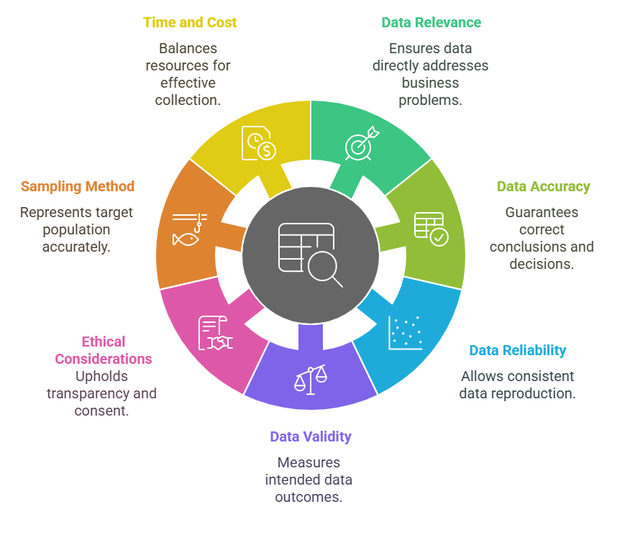
Key Factors to
Consider
Notes:
Data Relevance: It’s vital to collect only data that is directly tied to your business problem or research question. Irrelevant data can waste time and resources, making it harder to identify valuable insights. For instance, if you're studying customer satisfaction, focusing on unrelated data, such as website traffic, won’t contribute to solving the issue.
Data Accuracy: The accuracy of data ensures that your conclusions and decisions are based on reliable information. Inaccurate data can lead to wrong decisions, which can have significant business repercussions. Always use trusted sources and methods to collect data to maintain its integrity.
Data Reliability: Reliable data is consistent and can be reproduced under similar conditions. This means if you were to collect the same data again at a later time, the results should be similar. High reliability increases the trustworthiness of your conclusions.
Data Validity: Data validity ensures that the data measures what it is intended to measure. For example, if you are surveying customer satisfaction, your questions must focus on customer experiences, not unrelated topics like product features. This makes your data truly reflective of the area you’re trying to assess.
Ethical Considerations: Data collection should adhere to ethical guidelines. Always inform participants about how their data will be used and obtain their consent. This builds trust and ensures the integrity of your study. Additionally, confidentiality must be maintained to protect participants' privacy.
Sampling Method: The sampling method you choose affects the representativeness of your data. Random sampling ensures each participant has an equal chance of being selected, while stratified sampling targets specific subgroups. Choose a method that best suits your study’s needs.
Time and Cost: Every data collection process comes with constraints such as time, money, and workforce. Make sure to plan accordingly, ensuring you have the resources to complete the collection effectively while staying within budget and time limits.

Slide 4
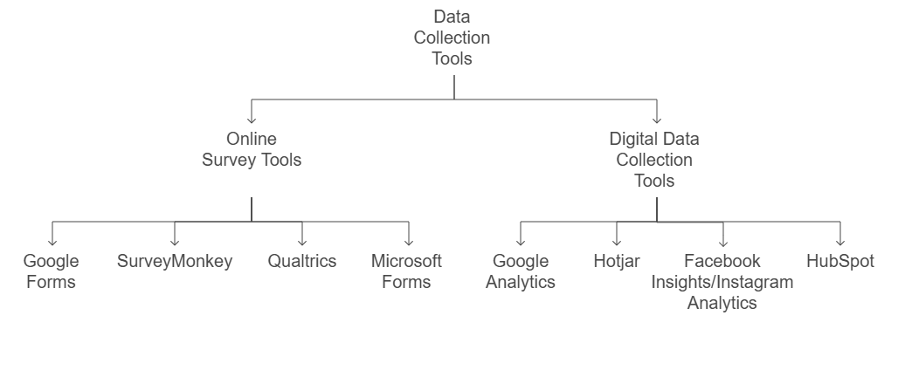
Data Collection Tools – Online
Notes:
Online Survey Tools:
Google Forms: A free and user-friendly tool, ideal for collecting basic survey data. It integrates well with Google Sheets, making data analysis easy.
SurveyMonkey: Offers more advanced features like branching logic and customizable designs, making it suitable for larger or more complex surveys.
Qualtrics: A professional-grade survey tool used in academic or corporate research. It provides extensive customization and powerful analytics tools for in-depth survey analysis.
Microsoft Forms: Similar to Google Forms but integrates seamlessly with Office 365, making it an excellent option for organizations using Microsoft tools.
Digital Data Collection Tools:
Google Analytics: Tracks website traffic, user behavior, and other digital interactions, giving businesses insights into their online presence.
Hotjar: Provides heatmaps and session recordings to help businesses understand how visitors interact with their website, optimizing user experience.
Facebook Insights/Instagram Analytics: These tools offer valuable data on social media engagement, helping businesses understand their audience’s demographics and behavior.
HubSpot: A CRM platform that tracks customer interactions, sales, and marketing data, providing a complete view of customer relationships and helping businesses optimize digital strategies.

Slide 5
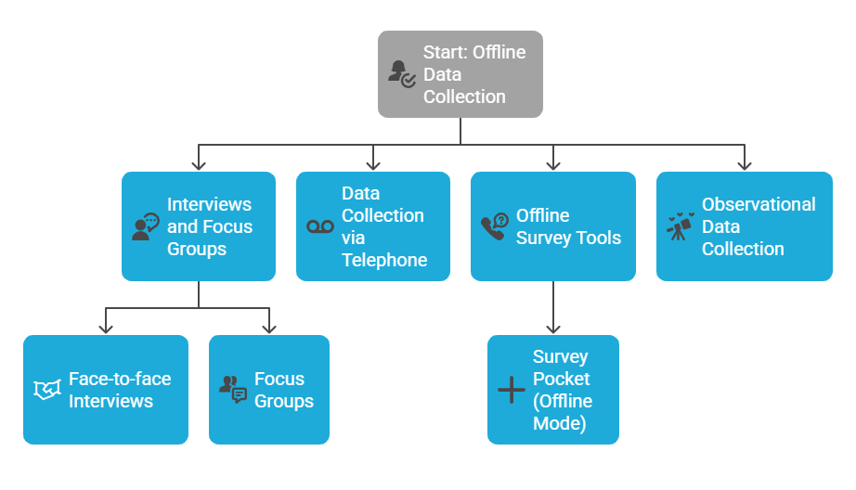
Data Collection Tools – Offline
Notes:
Interviews and Focus Groups:
Face-to-face Interviews: A direct method to gather in-depth, qualitative data. Respondents provide open-ended answers, allowing you to understand their perspectives more deeply.
Focus Groups: These group discussions help gather qualitative insights, especially useful for exploring ideas, behaviors, and perceptions. A moderator guides the discussion to ensure all topics are covered.
Data Collection via Telephone: Conducting interviews or surveys over the phone allows businesses to reach a broader demographic, especially when face-to-face meetings are not feasible. This method works well for remote or widespread populations.
Offline Survey Tools:
Survey Pocket (Offline Mode): This mobile app lets you collect survey data even without an internet connection, making it suitable for field surveys in areas with limited connectivity.
Observational Data Collection: Sometimes, data is best gathered by simply observing behaviors or events. This method is often used in qualitative research, where you study actions without interference. It’s particularly useful for understanding patterns or behaviors in natural settings.

Slide 6
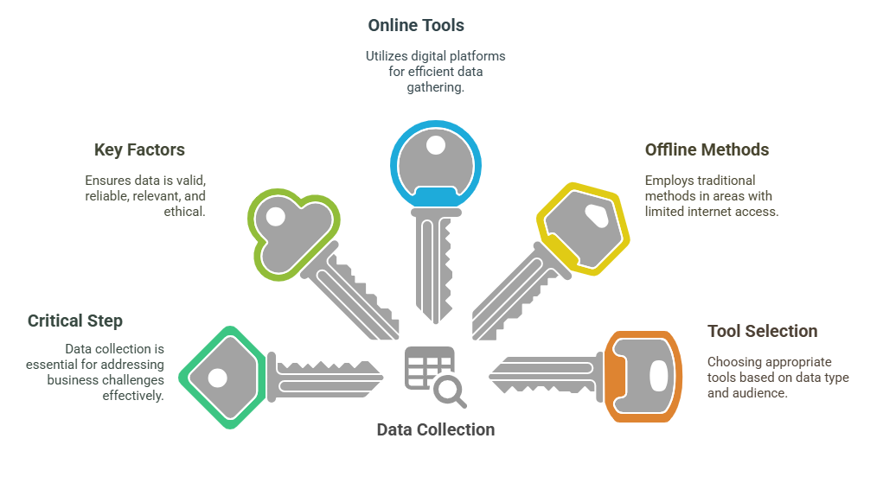
5 Key Learning Points of this Lesson
Notes:
Data Collection is a Critical Step: Once a business problem is defined, gathering the right data is essential to uncover solutions and inform decision-making. Without proper data, solutions can be misguided and ineffective.
Factors to Consider in Data Collection: It’s crucial to ensure the data is relevant, reliable, and valid. Ethical concerns also play a significant role, as businesses must respect privacy and transparency.
Online Tools for Surveys and Digital Data: Tools like Google Forms and SurveyMonkey help businesses collect survey data quickly and efficiently, while platforms like Google Analytics and Hotjar gather important digital interaction data.
Offline Data Collection Methods: For regions or scenarios where internet access is limited, or when personal interactions are necessary, offline methods such as interviews and surveys with apps like Survey Pocket are effective.
Choosing the Right Data Collection Tool: The choice of data collection tool should depend on factors like the type of data needed, the target audience, and available resources. Selecting the right tool ensures accurate and meaningful results.

Slide 7
Thank You!
Shahriar’s Analytical Academy

